Slide 1
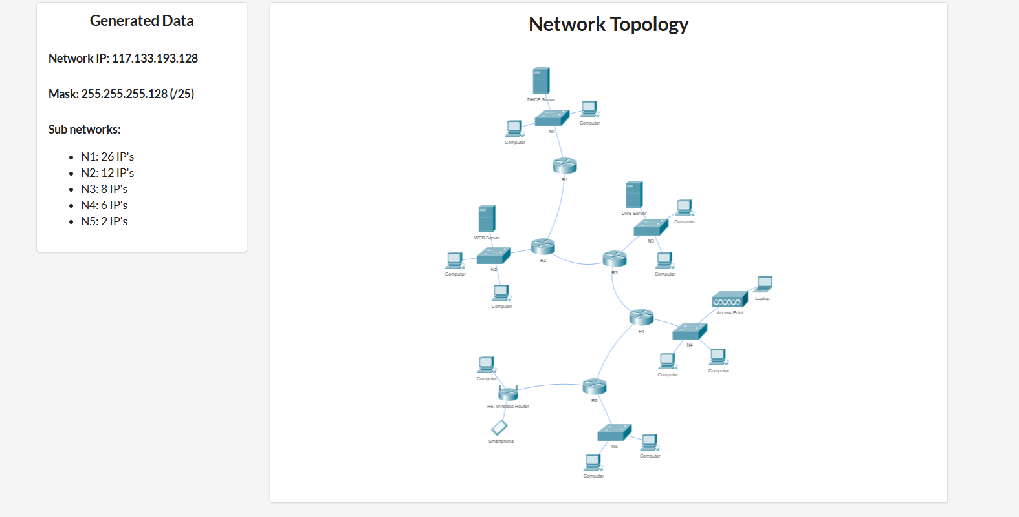
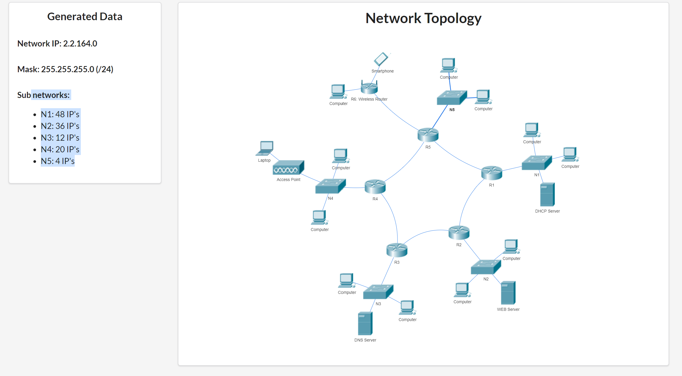
N
1
2
N45
N15
N23
N34
N12
N34
N23
N45

Slide 2
adresa de retea: 117.133.193.128 netmask: 255.255.255.128 adresa ip inceput: 117.133.193.128 adresa ip final: 117.133.193.255 Nr IP-uri totale = 128 IP-uri
Adrese IP ramase:
117.133.193.236/30 --- 117.133.193.239
117.133.193.240/28 --- 117.133.193.255
Retea | Nr IP-uri | Dimensiunea retelei | Adresa de retea | adresa de broadcast
N1 | 26 + Adresa de retea + broadcast + default gateway | 32 | 117.133.193.128/27 | 117.133.193.159
N2 | 12 + 3 | 16 | 117.133.193.160/28 | 117.133.193.175
N3 | 8 +3 | 16 | 117.133.193.176/28 | 117.133.193.191
N4 | 6 + 3 | 16 | 117.133.193.192/28 | 117.133.193.207
N5 | 2 + 3 | 8 | 117.133.193.208/29 | 117.133.193.215
N12 | 2 + adresa de retea + broadcast | 4 | 117.133.193.216/30 | 117.133.193.219
N23 | 2 + 2 | 4 | 117.133.193.220/30 | 117.133.193.223
N34 | 2 + 2 | 4 | 117.133.193.224/30 | 117.133.193.227
N45 | 2+ 2 | 4 | 117.133.193.228/30 | 117.133.193.231
NWifi | 2 + 2 | 4 | 117.133.193.232/30 | 117.133.193.236

Slide 3
0... 255
(256 IP-uri)
0..127
(128 IP-uri)
0..63
(64 IP-uri) N1
64 ..127
(64 IP-uri N2)
128.. 255
(128 IP-uri)
64..95
32 IP-uri
96 ... 127
32 IP-uri
64..79
16 IP-uri
80.. 95
16 IP-uri
96..111
16 IP-uri
112 .. 127 16 IP-uri
96..103
8 IP-uri
104 ..111
8 IP-uri
112 .. 119
8 IP-uri
120 .. 127
8 IP-uri
112 .. 115
4 IP-uri
116 .. 119
4 IP-uri
120.. 123
4 IP-uri
124 .. 127
4 IP-uri

Slide 4
Rutare statica
Nume retea | Adresa de retea | Vecin

